Slide 1
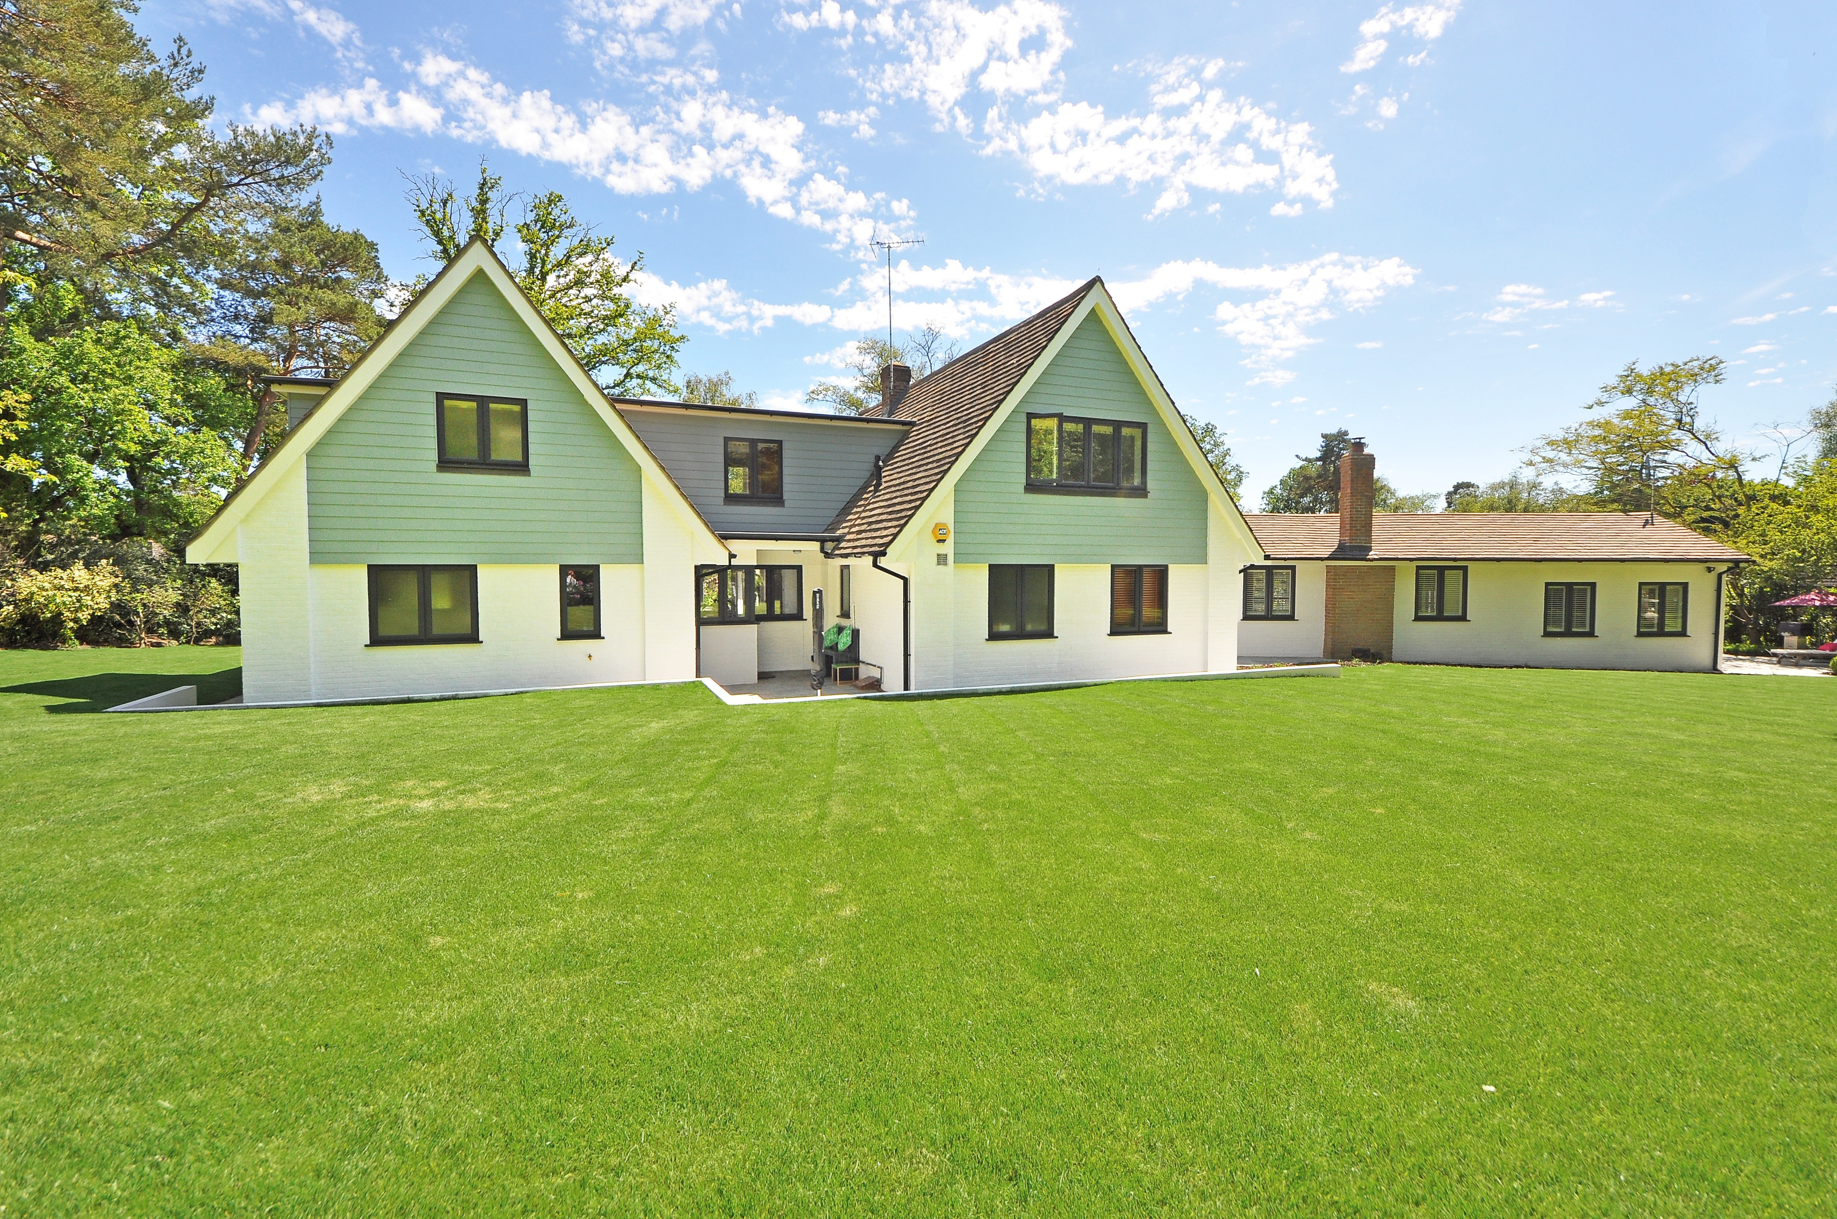
Exploratory Data Analysis (EDA) for House Pricing
Submitted By :
Rupesh Dewangan

Slide 2

1
What is EDA?
CONTENTS
2
Data Description
3
Data Cleaning & Preprocessing
4
Univariate,Bivariate & Multivatiate Analysis
5
Feature Engineering

Slide 3

What is EDA?
Exploratory Data Analysis (EDA) for real estate pricing involves examining a dataset of house listings to identify patterns, trends, and key factors influencing property values, providing insights into the market dynamics and helping to understand how various features like location, size, amenities, and market conditions impact house valuation in a dynamic environment.

Slide 4

Importance of EDA in Real Estate Pricing:
Data Understanding – Helps in assessing the quality of data, identifying missing values, and detecting outliers.
Feature Relationships – Analyzes the impact of various factors (e.g., location, size, amenities) on house prices.
Market Trends – Identifies patterns such as seasonal price fluctuations and emerging real estate hotspots.
Decision-Making – Provides insights that assist buyers, sellers, and investors in making informed decisions.

Slide 5

Data cleaning and preprocessing
Handling Missing Values
Feature Engineering
Numerical Features (e.g., Price, Square Footage, Lot Size)
Categorical Features (e.g., Location, Property Type)
Creating new features can improve insights and predictive power.
Outlier Detection and Treatment
Feature selection
Boxplots & IQR
Visualizations (Scatter Plots, Histograms)
Identify the most relevant features to include in predictive models for property valuation.

Slide 6
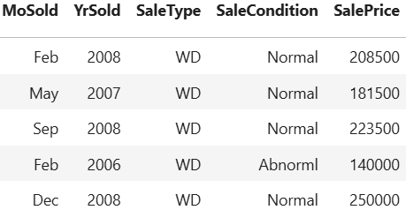
Data Description
Dataset Overview
The dataset used for this Exploratory Data Analysis (EDA) consists of real estate transactions, including property characteristics, pricing details, and market trends. The goal is to analyze how different factors influence house prices and identify key patterns in the housing market.
Collect the Data Source in the form of CSV or XLS
Go with Observations and Features
Property Characteristics:
Price ($): The target variable representing the house sale price.
Location: City, neighborhood,zip code where the property is situated
Square Footage (sq ft): Total area of the house.
Number of Bedrooms: Count of bedrooms in the property.
Number of Bathrooms: Count of bathrooms, full and half.
Year Built: Construction year of the house.
70%
70

Slide 7

Data Cleaning & Preprocessing
Data cleaning and preprocessing are essential steps in Exploratory Data Analysis (EDA) to ensure the dataset is accurate, consistent, and ready for meaningful insights. This involves
Handling Missing Values
Outlier Detection & Treatment
Feature Engineering

Slide 8
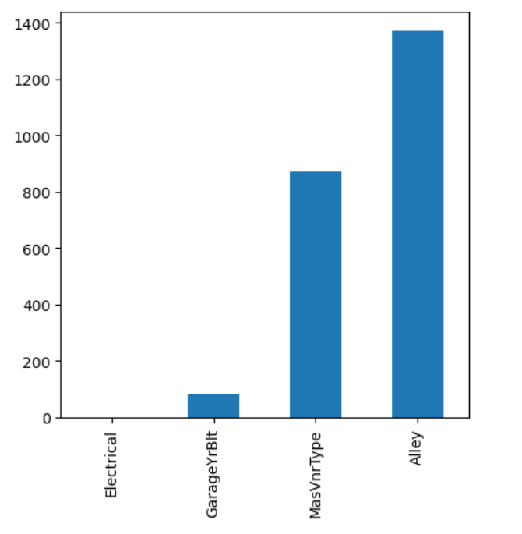
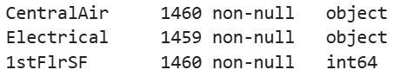
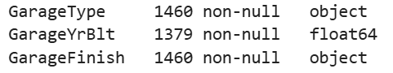
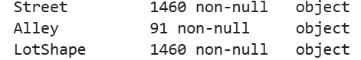
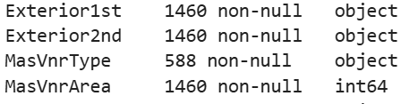
Missing values
Here we can see missing values in Alley,MasVnrType, GarageYrBlt, Electrical features

Slide 9
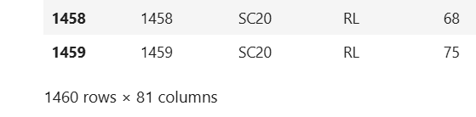
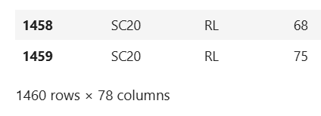
Cleaned Data after Handlled the missing Values
Before cleaning data
Cleaned data

Slide 10
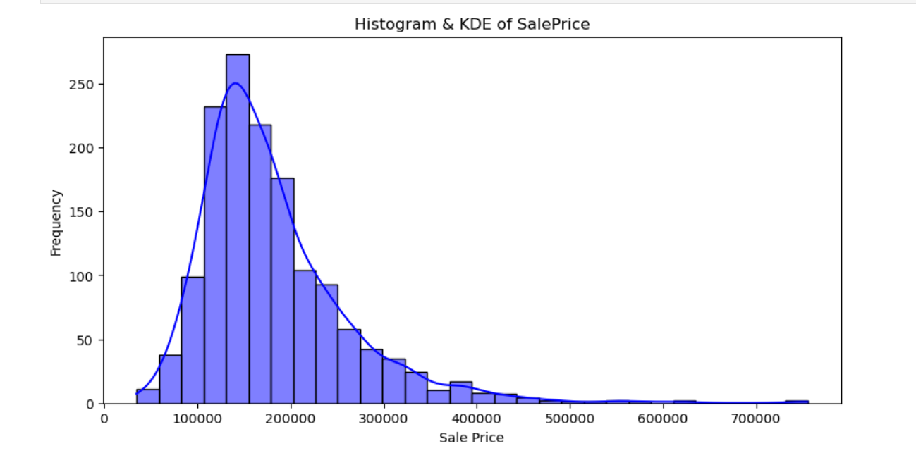
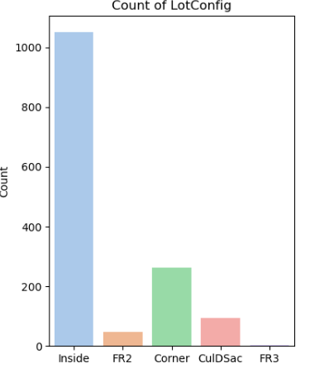
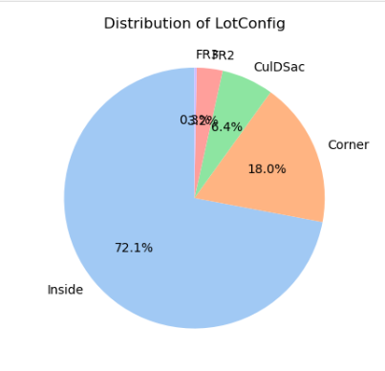
Univariate Analysis: Price Distribution (Histogram + KDE Plot)
Univariate analysis examines one variable at a time to understand its distribution, central tendency, and variability. This helps identify trends, outliers, and data characteristics before diving into deeper insights.
Numerical variable Histplot with KDE of salesprice distribution
Categorical variable Countplot of Location Configuration
Categorical variable Pie plot for Distribution of Location Configuration

Slide 11
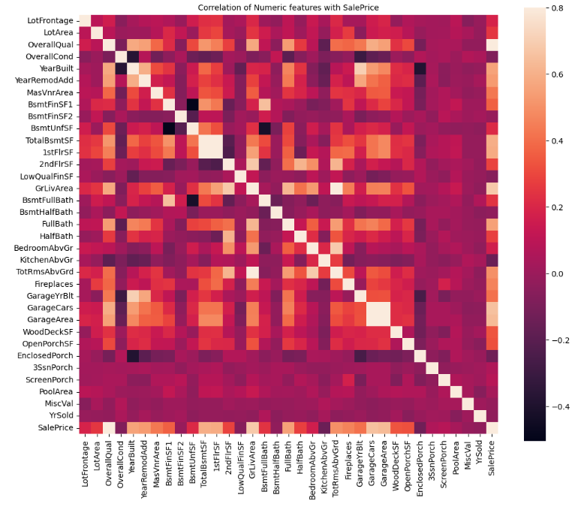
Correlation
Correlation of Numeric features with SalePrice
Dark pattern shows one feature correlated with negatively with other
feature,
example :
Here BsmtUnfSF in y-axis is very highly negatively correlated with BsmtFinSF1 in x-axis.

Slide 12
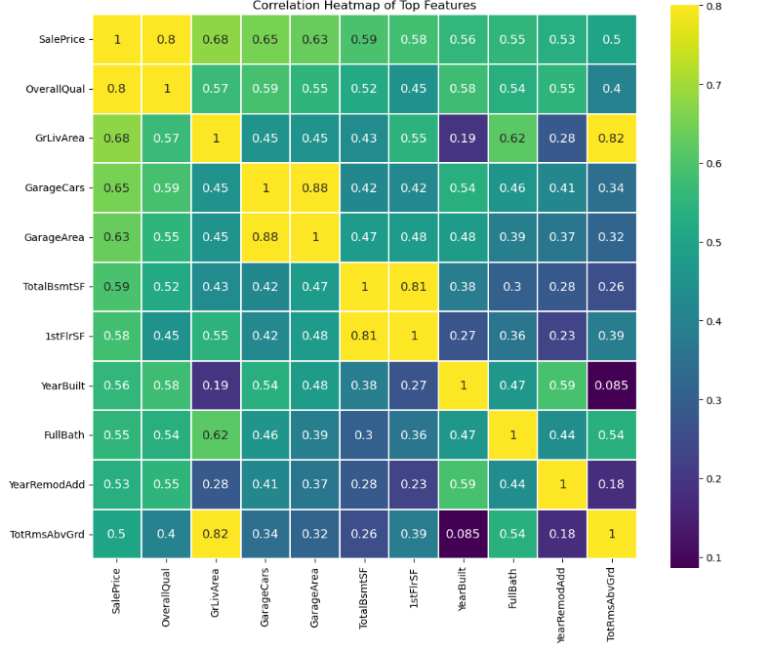
cntd... Correlation Heatmap of Top Features
In this Heatmap Yellow colored shows highly correlated features example 0.8,0.82,0.88,0.81,1, etc... According to this Heatmap GarageArea in Y-axis highly correlated with GarageCars in x axis

Slide 13
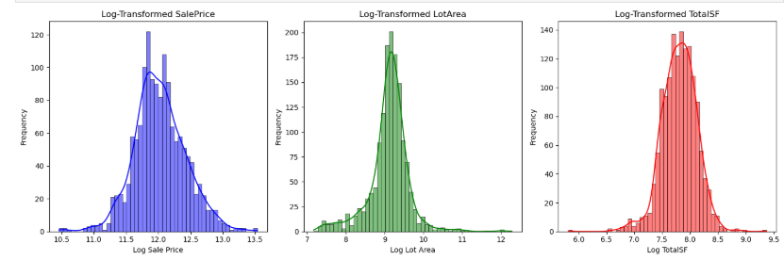
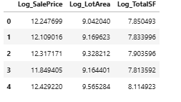
Feature Engineering for House Price Prediction
Feature engineering transforms raw data into meaningful features that improve predictive models. In real estate pricing, creating new features and modifying existing ones can enhance model performance.
example:Combine GrLivArea (above ground) and TotalBsmtSF (basement) into a new feature
According to given data created new feature like shown below
TotalBath = FullBath+HalfBath+BsmtFullBath+BsmtHalfBath

Slide 14
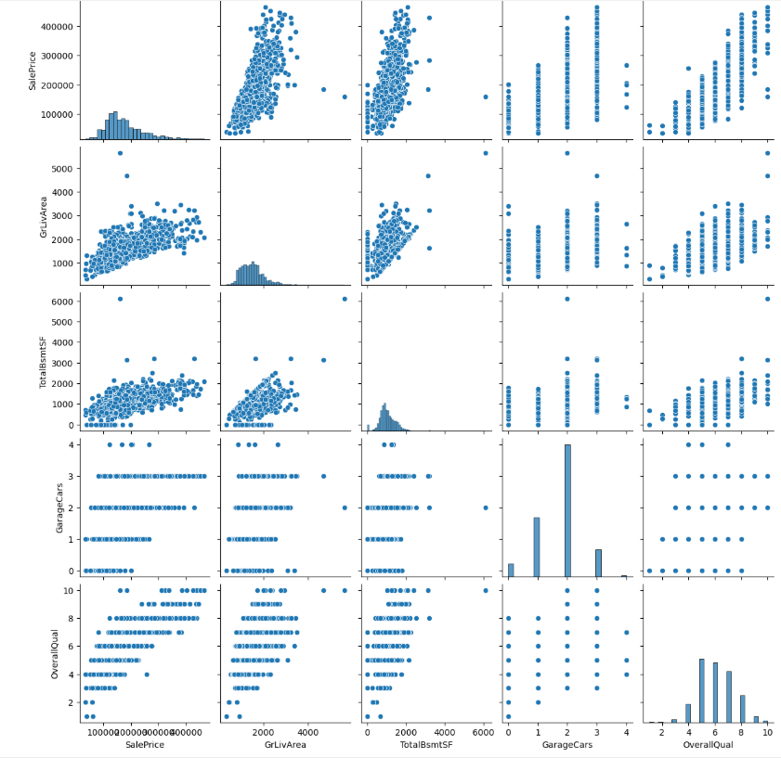
Multivariate Analysis (Multiple Variables)
Multivariate analysis examines multiple variables simultaneously to understand complex relationships between factors affecting house prices. This helps in feature selection and predictive modeling.
SalePrice vs. Other Features:
Higher quality homes (OverallQual) tend to have higher prices.
Larger living areas (GrLivArea) and basements (TotalBsmtSF) increase prices.
GarageCars vs. SalePrice:
More garage spaces generally lead to higher prices

Slide 15
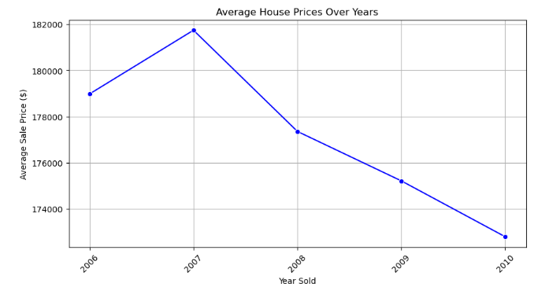
Market Trends & Historical Pricing Analysis
Market trends and historical pricing analysis help identify long-term patterns, seasonal fluctuations, and economic impacts on housing prices.
According to visualization in 2007 Average House Price was very high.

Slide 16
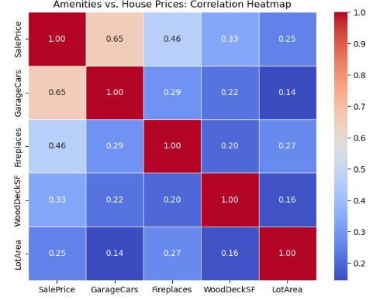
Customer Preferences and Amenities Impact on House Prices
Understanding what buyers prioritize helps in predicting house prices and identifying high-value features. Certain amenities and characteristics increase desirability and pricing, while others may have a lower impact.
Bigger homes (GrLivArea) → Higher prices.
Garage Spaces (GarageCars) → More garage capacity increases property value.

Slide 17
THANK YOU

